Slide 1
911 Calls Prediction Problem
Please click the link below to watch the short video about my experience and methodology for this coding challenge:
Click here
or paste this link in the browser:
https://drive.google.com/file/d/1_HOpnZjLeK8NxnZW4C0XjUPpT4vt7PXn/view?usp=sharing

Slide 2
Daily calls

Slide 3
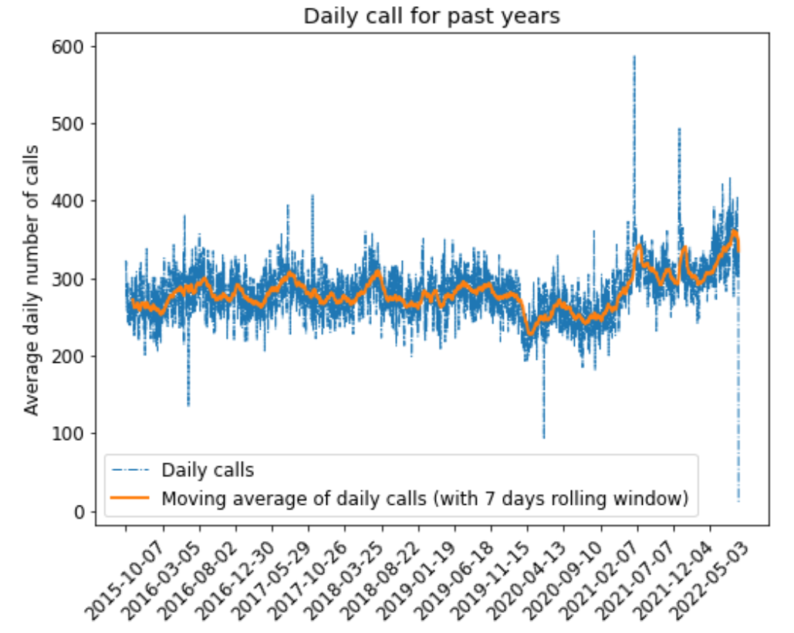
Daily calls
The number of calls per day for the last 7 years are plotted
The series appears to be very noisy
The yellow curve represents the moving average of daily with 7 days rolling window

Slide 4
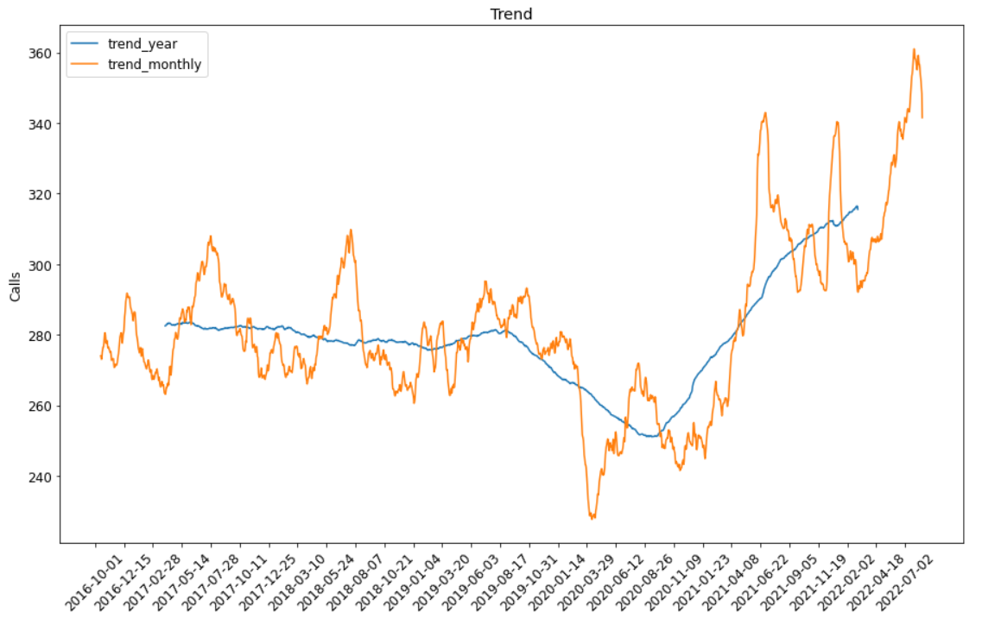
Trend analysis of daily calls
The trend graph is made using additive seasonal decomposition of the time series
The series exhibits an almost steady trend before 2019 end (Covid pandemic)
During the pandemic, the calls went down that normal and then again rose up after 2020.
There is an upward trend for the time after 2020. Probably could be because of the health, political and economic issues that came after pandemic.

Slide 5
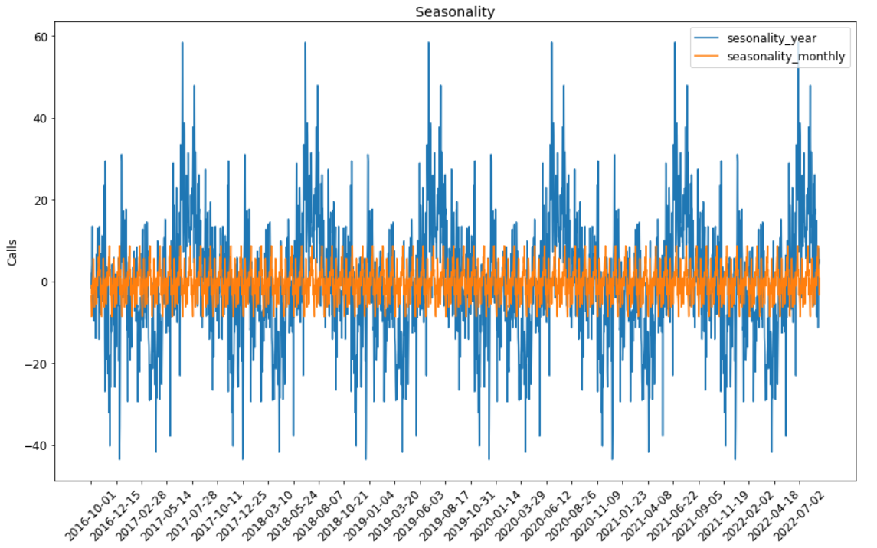
Seasonality analysis of daily calls
It can be observed that there are multiple seasonality in the series
There is monthly as well as yearly seasonality

Slide 6
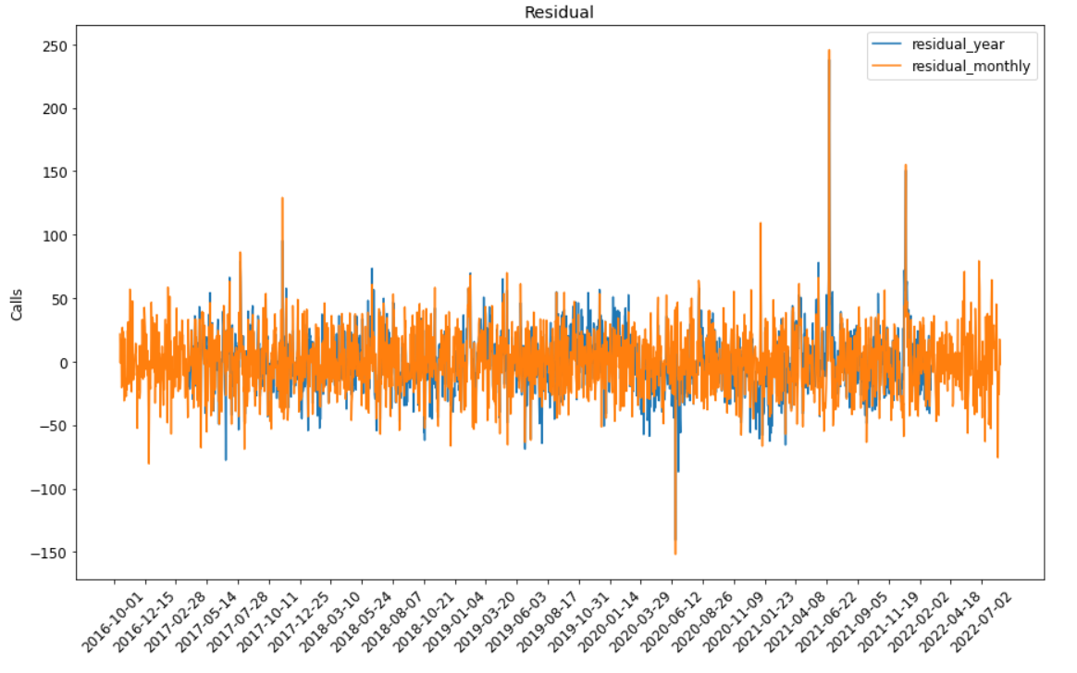
Residual analysis of daily calls
It can be observed that there is a noise residual in the time series too.

Slide 7
Input dataframe
Only the date, time are used from the 911 calls dataset.
The Lat, Long and the address are not used as inputs
Columns are made containing the year, month, day, hour
It was mentioned that the weather data could be useful, so I also fetched the weather data from wwo weather API and augmented it to the input dataset
The seasonality, autocorrelation check indicated that the past values could be used to improve the predictions
Last 5 values of the calls are augmented to input dataframe
Metric of mean squared error and mean absolute error has been used

Slide 8
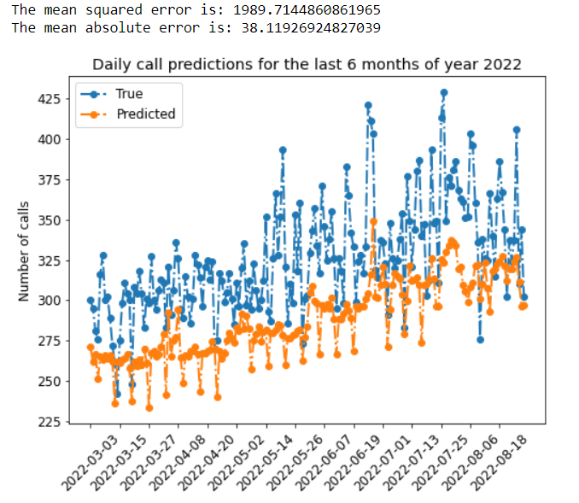
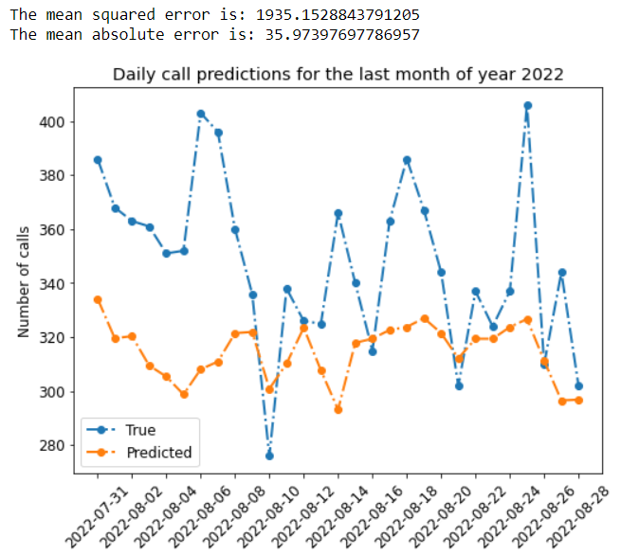
Modelling (without past values augmented) – Gradient Boosting

Slide 9
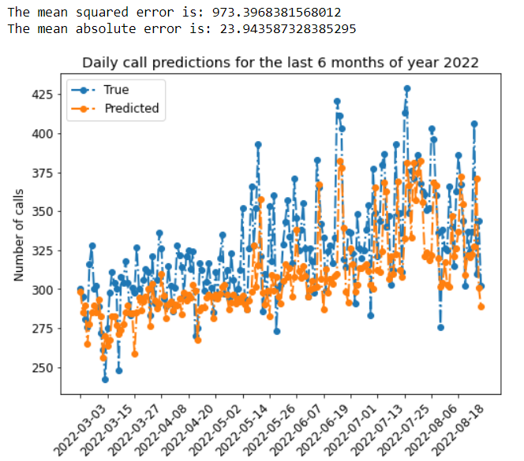
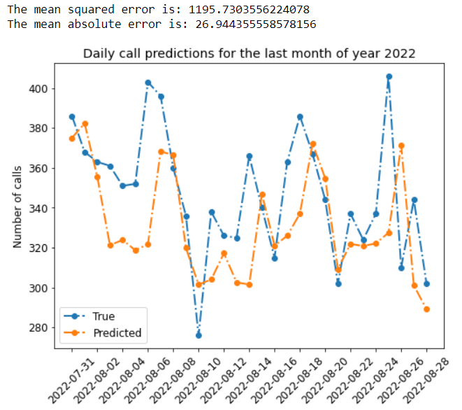
Modelling (with past values augmented) – Gradient Boosting
It can be seen the prediction are better and the error reduced after augmenting the previous values
It was observed that there was a change in trend during and after covid 19. The next slide shows same modelling method but for 2018, using data from 2017 to 2013.

Slide 10
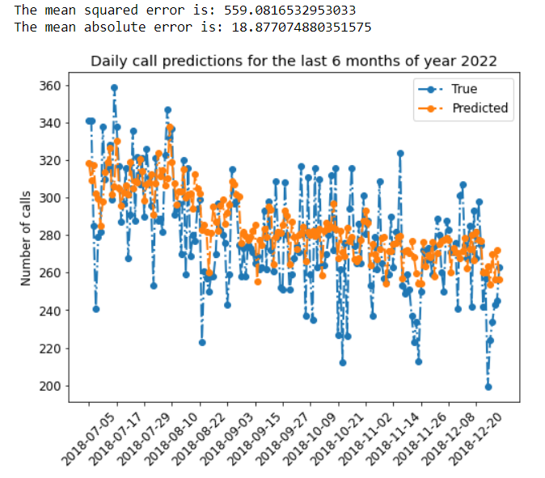
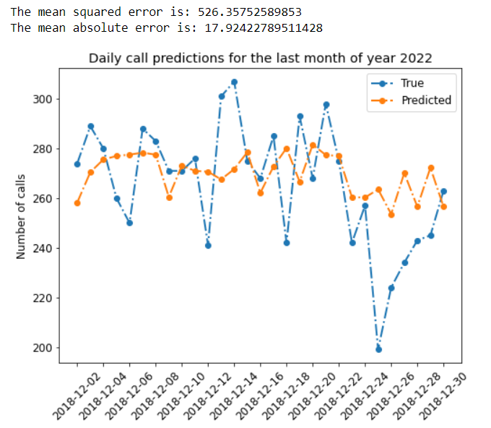
Modelling (with past values augmented) – Gradient Boosting
It can be seen the prediction are better and the error reduced after for the predictions before covid.
It means that more information is required so that the change in series trend can be learned. The predictions improved by a slight margin when the modelling was done using past 18 months only (using 2022 series too) to predict the last month of 2022

Slide 11
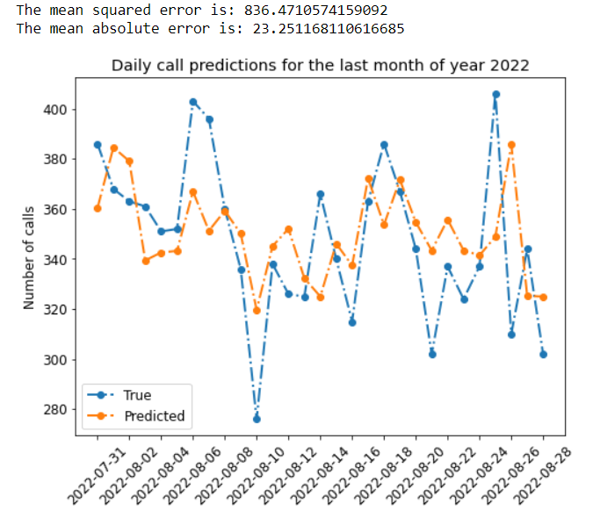
Modelling (with past values augmented) – Gradient Boosting
Findings:
The mean absolute error between the prediction and the true value for a month of 2018 is almost 40% lesser than that of 2022.
This also suggested that more information/features is/are required to model the change that has happened after covid, if the last 5 years data is to be used for training.
The prediction were slightly better when using past few months data before 2022 last month
Providing previous information improved the modelling results
Moreover, there is a lot of noise component present in the time series, which requires a different model to model it correctly.

Slide 12
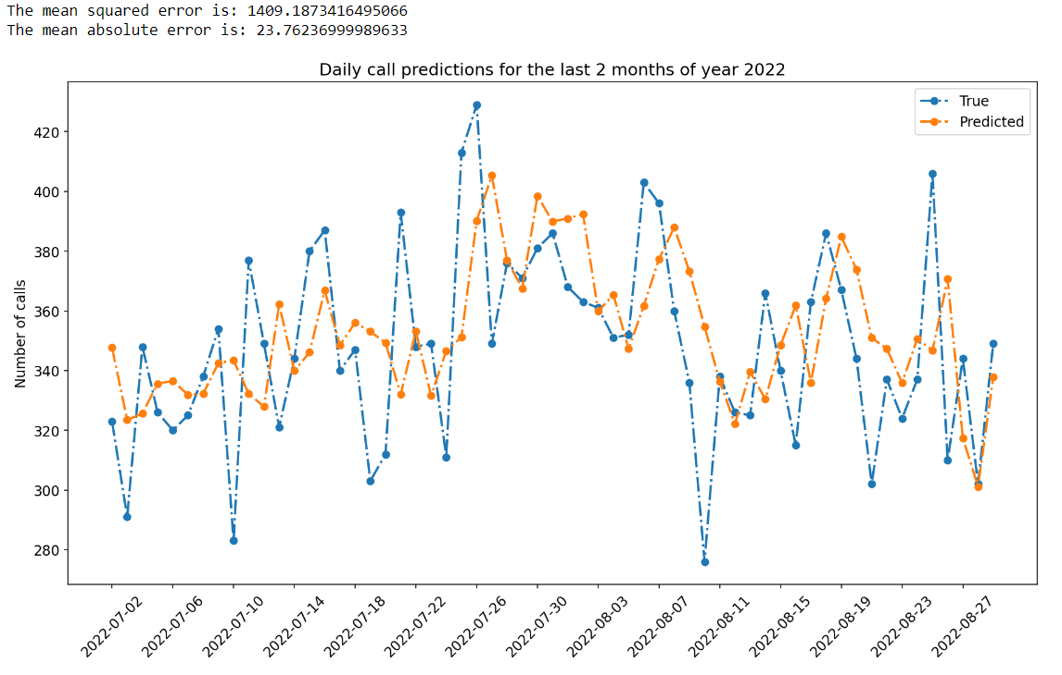
Modelling (with past values augmented) – ANN
Findings:
ANN also provided similar results as Gradient Boosting (The data preprocessing for ANN can be found in the notebook)
The seasonality, trend and residual analysis showed that statistical models such as ARIMA and SARIMA can also be used.
I also studied about the darts library that can be used for time series prediction.
Further more, the series can also be analysed using Fourier transformation and modelling the frequency components separately
They were not implemented for the task, due to the time constraint but it can provide better predictions.

Slide 13
Hourly calls

Slide 14
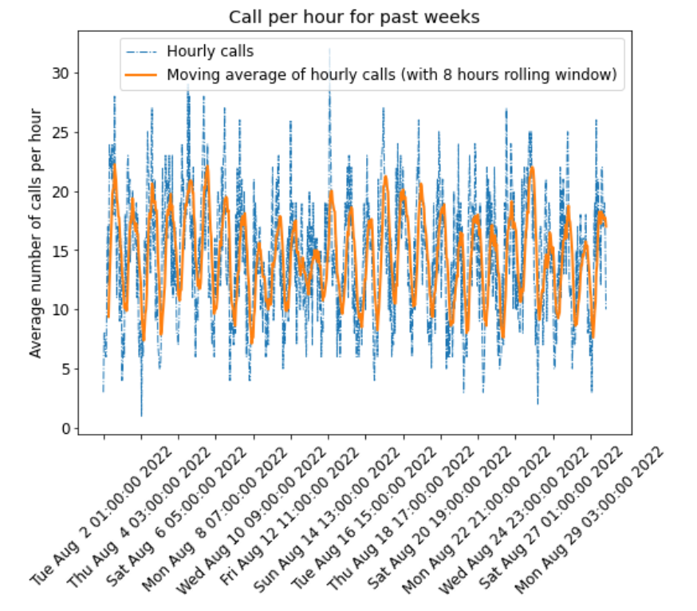
Hourly Calls
It can be clearly seen that the there is seasonality in the hourly calls.
The series is almost stationary
It exhibits a daily seasonality
The trend, seasonality and residual analysis shows that the hourly call series also has noise/ residual nature part

Slide 15
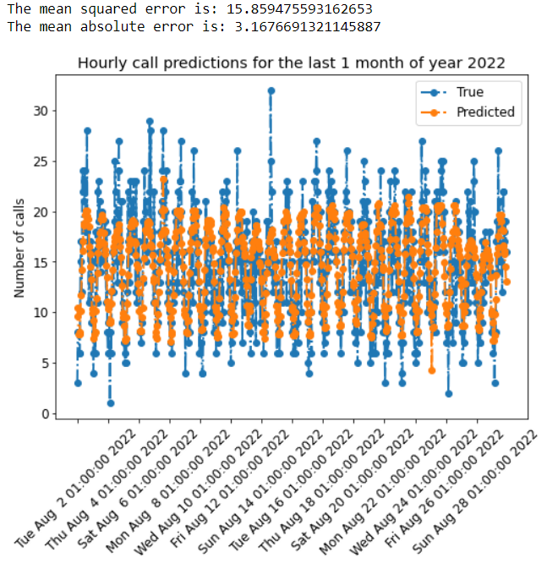
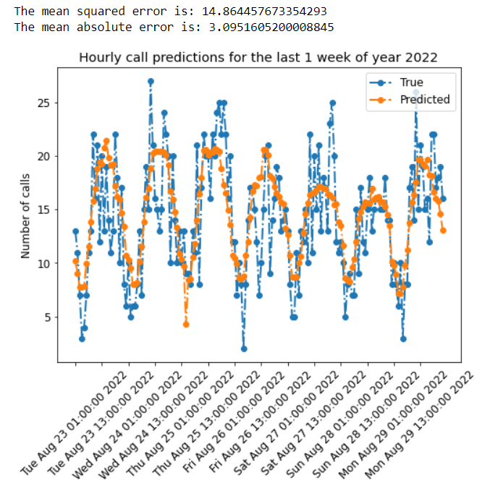
Modelling (without past values): Gradient Boosting

Slide 16
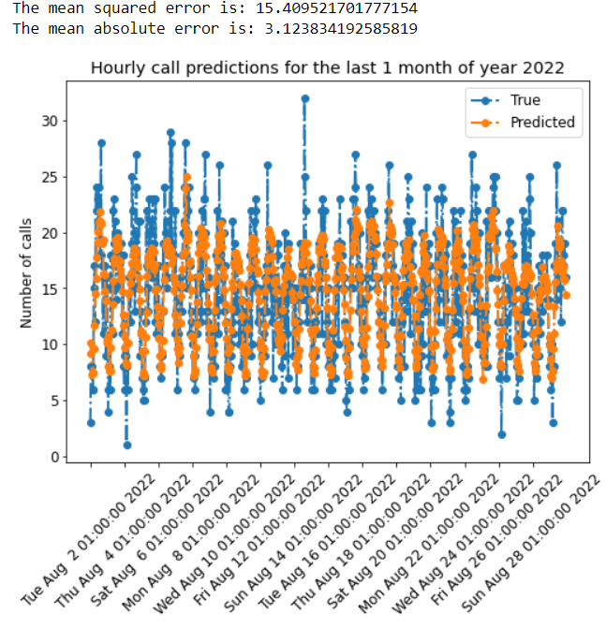
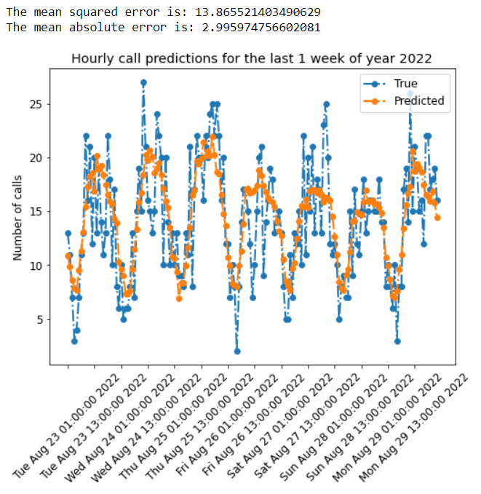
Modelling (with past values): Gradient Boosting

Slide 17
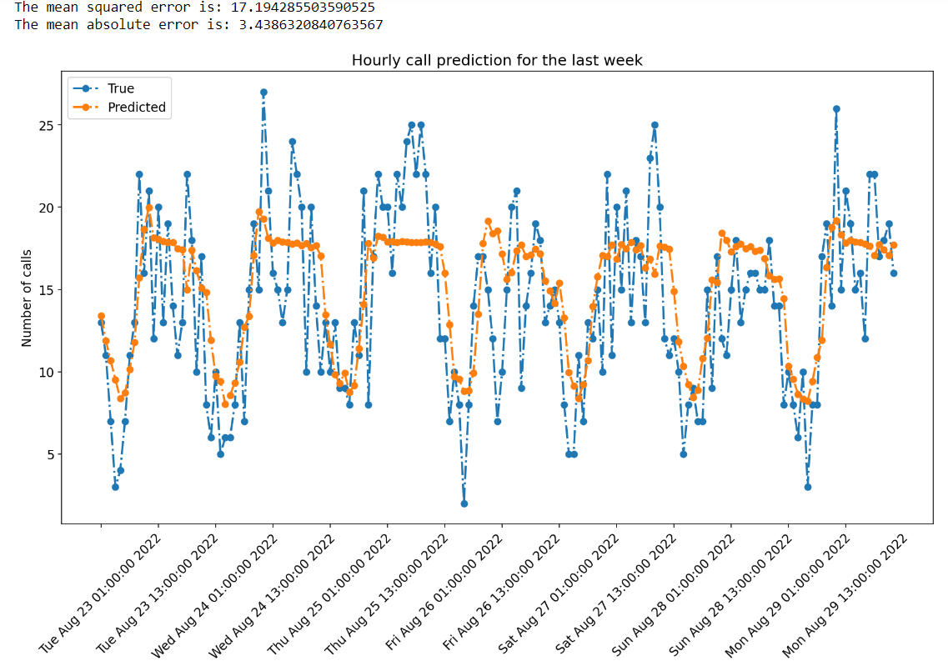
Modelling (with past values): ANN
Findings:
Providing previous information improved the modelling results
Moreover, there is a lot of noise component present in the time series, which requires a different model to model it correctly.
Gradient boosting performed better than ANN for hourly prediction. But efforts could be made to optimize the hyperparameters

